Slide 1
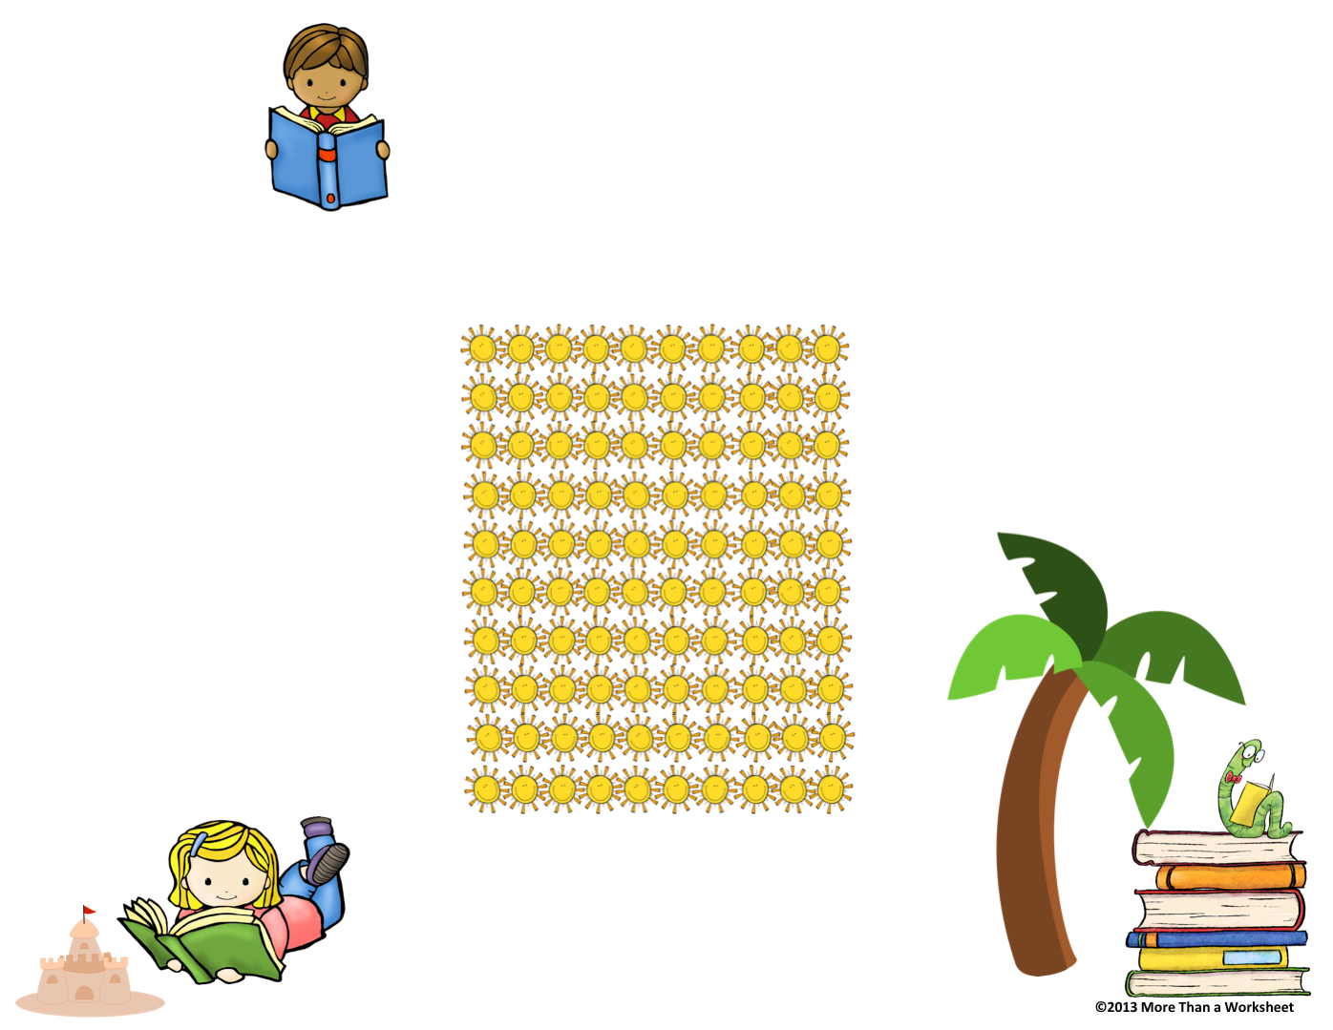
Summer Reading
Challenge
Summer
Reading
Ideas
Summer
Reading
Goal: Read 100 books this summer!
Each sun represents 1 book. Every time you read a book, check off one sun. When you check all of the suns, that means you have read 100 books!
*Visit the public library
*Visit the bookstore
*Listen to books while driving
*Take turns reading
*Find fun places to read
*Try a new book series
*Re-read an old favorite
*Swap books with a friend
*Find books at a thrift store
*Read books about places you hope to visit one day
*Have a family poetry reading night with a microphone
*Have a reading picnic on a blanket outside
*Read books, then watch the movie version and compare
Paideia School 15
Title 1 Reading
Mrs. Goggin
Mrs. Engeldrum
I read ______ books this summer!
My favorite book that I read:
__________________________________

Slide 2
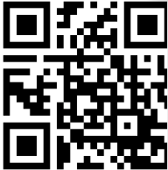
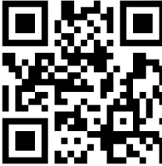
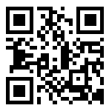
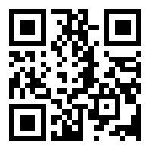
Recommended
Authors
Grades K-2
Eric Carle
Margaret Wise Brown
Leo Leonni
Mary Pope Osborne
Dr. Seuss
Sandra Boynton
Barbara Park
Donald Crews
Lois Ehlert
Bill Martin Jr.
Jan Brett
Marc Brown
Tomie DePaola
Steven Kellogg
Maurice Sendak
Jane Yolen
Grades 3-5
Sharon Creech
Louis Sachar
Lemony Snicket
Shel Slverstein
Jeff Kinney
RJ Palacio
Lois Lowry
Jack Prelutsky
Madeline L’Engle
Beverly Cleary
Patricia Polacco
EB White
Roald Dahl
Chris VanAllsburg
Judy Blume
Jean Fritz
Read a
Book Online
Dear Parents,
Your child has worked very hard this year! According to research,* students who do not read over the summer can lose as much as 22% of their reading level. That means 2 months of school, down the drain!
You can help prevent this summer reading loss by encouraging your child to read over the summer. Try to read something everyday, whether it’s a book, recipe, or a menu. Every word counts.
Here’s to making this a summer of reading!
Sincerely,
Mrs. Goggin &
Mrs. Engeldrum
*Research from Reading is Fundamental
(www.rif.org)
Here are some great
websites to read online:
Storyline Online—celebrities read aloud favorite children’s books http://www.storylineonline.net
International Children’s Library—a large collection of stories from around the world http://en.childrenslibrary.org
Storynory—a variety of fun and colorful stories to read online http://www.storynory.com
DOGOnews—current events news stories and articles on a variety of nonfiction topics https://dogonews.com
Also, check with your local the Yonkers Public Library for more resources.

Slide 3
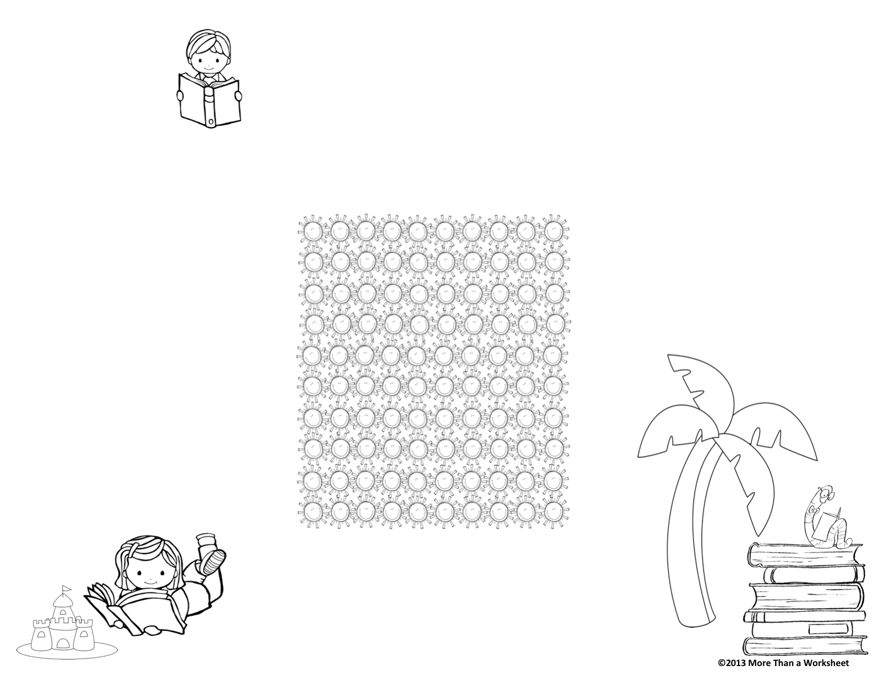
Summer Reading
Challenge
Summer
Reading
Summer
Reading
Ideas
Goal: Read 100 books this summer!
Each sun represents 1 book. Every time you read a book, color in one sun. When you color all of the suns, that means you have read 100 books!
*Visit the public library
*Visit the bookstore
*Listen to books while driving
*Take turns reading
*Find fun places to read
*Try a new book series
*Re-read an old favorite
*Swap books with a friend
*Find books at a thrift store
*Read books about places you hope to visit one day
*Have a family poetry reading night with a microphone
*Have a reading picnic on a blanket outside
*Read books, then watch the movie version and compare
Paideia School 15
Title 1
Mrs. Goggin
Mrs. Engeldrum
I read ______ books this summer!
My favorite book that I read:
__________________________________

Slide 4
Recommended
Authors
Grades K-2
Eric Carle
Margaret Wise Brown
Leo Leonni
Mary Pope Osborne
Dr. Seuss
Sandra Boynton
Barbara Park
Donald Crews
Lois Ehlert
Bill Martin Jr.
Jan Brett
Marc Brown
Tomie DePaola
Steven Kellogg
Maurice Sendak
Jane Yolen
Grades 3-5
Sharon Creech
Louis Sachar
Lemony Snicket
Shel Slverstein
Jeff Kinney
RJ Palacio
Lois Lowry
Jack Prelutsky
Madeline L’Engle
Beverly Cleary
Patricia Polacco
EB White
Roald Dahl
Chris VanAllsburg
Judy Blume
Jean Fritz
Read a
Book Online
Dear Parents,
Your child has worked very hard this year! According to research,* students who do not read over the summer can lose as much as 22% of their reading level. That means 2 months of school, down the drain!
You can help prevent this summer reading loss by encouraging your child to read over the summer. Try to read something everyday, whether it’s a book, recipe, or a menu. Every word counts.
Here’s to making this a summer of reading!
Sincerely,
Mrs. Goggin &
Mrs. Engeldrum
*Research from Reading is Fundamental
(www.rif.org)
Here are some great
websites to read online:
Storyline Online—celebrities read aloud favorite children’s books http://www.storylineonline.net
International Children’s Library—a large collection of stories from around the world http://en.childrenslibrary.org
Storynory—a variety of fun and colorful stories to read online http://www.storynory.com
DOGOnews—current events news stories and articles on a variety of nonfiction topics https://dogonews.com
Also, check with the Yonkers Public Library for more resources.

